Slide 1





Giants of the air:
How big could they be?
Colin Palmer
Mike Habib

Slide 2
Get into the air
Stay up
Land safely
Notes:
In order to fly, they need to be able to get into the air, stay there and stay in one piece (without excessive bone stresses or wing bone bending) and to land safely.

Slide 3
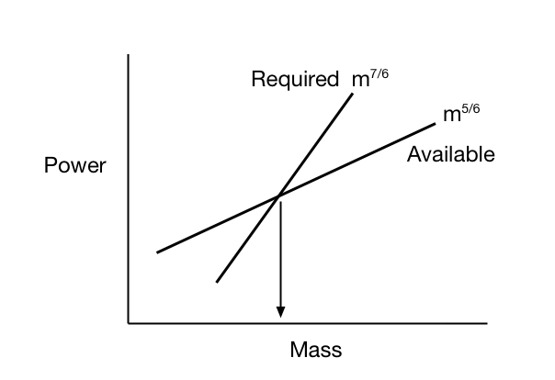
Power scaling

Slide 4
Power factor ratio
0.01
0.1
1.0
10.0
100.0
Body mass kg
Pennycuick 1996

Slide 5
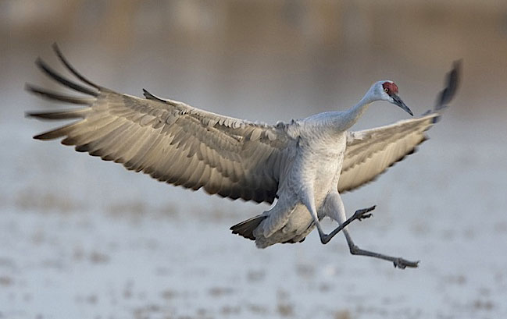
Landing
Estimate landing speed
Time stepping model
Simple quasi static approach
Calibrated for birds: 4-8m/s

Slide 6
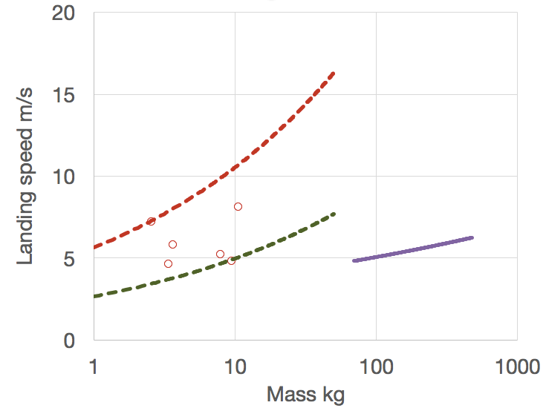
Landing speed
Birds
Swan
Pterosaurs

Slide 7
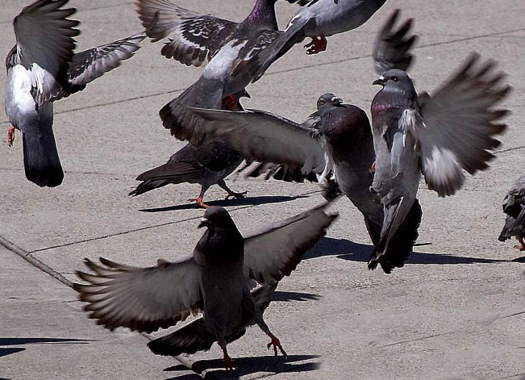
Getting into the air
Leap >80%
Earls force profile
Wing tip downstroke clearance
Constant leap height:size ratio
Earls 2000

Slide 8
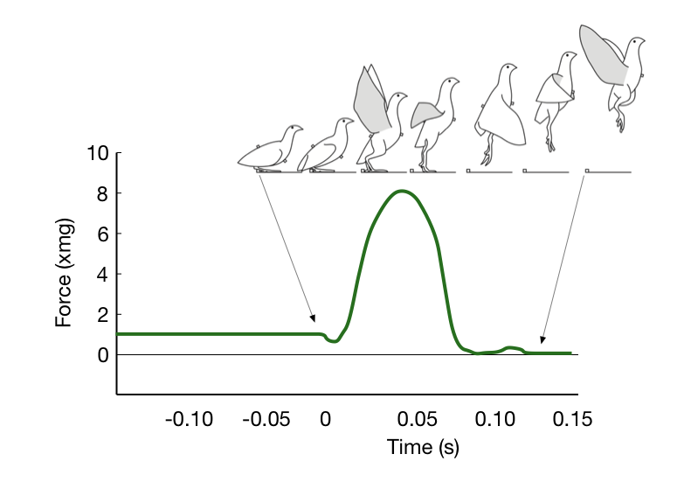
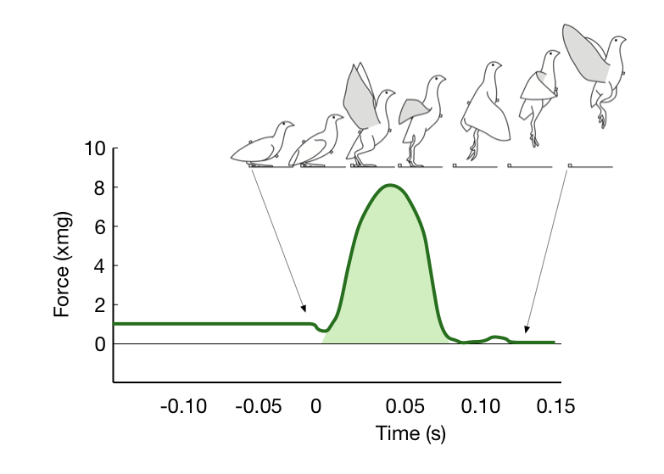
Launch impulse
Max. force
Launch impulse
Stroke
Earls 2000

Slide 9
Max. force exerted by animals
1000
Force
-1/3
1000
=
20m
Body weight
Force/body weight
10
0.1
0.001
1.0
1000
Body mass kg
Alexander 1985

Slide 10
Take-off scaling
Impulse = change in momentum (δmV)
Speed = 0 to lift-off speed (V)
V
2
Ballistic height =
2g
Impulse α l
3.5
isometrically
Impulse α l
2
Alexander 1985
Stroke α l
2

Slide 11
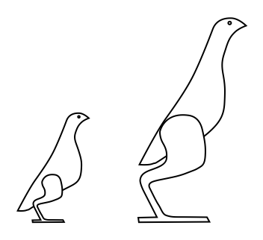
Bird leg allometry

Slide 12
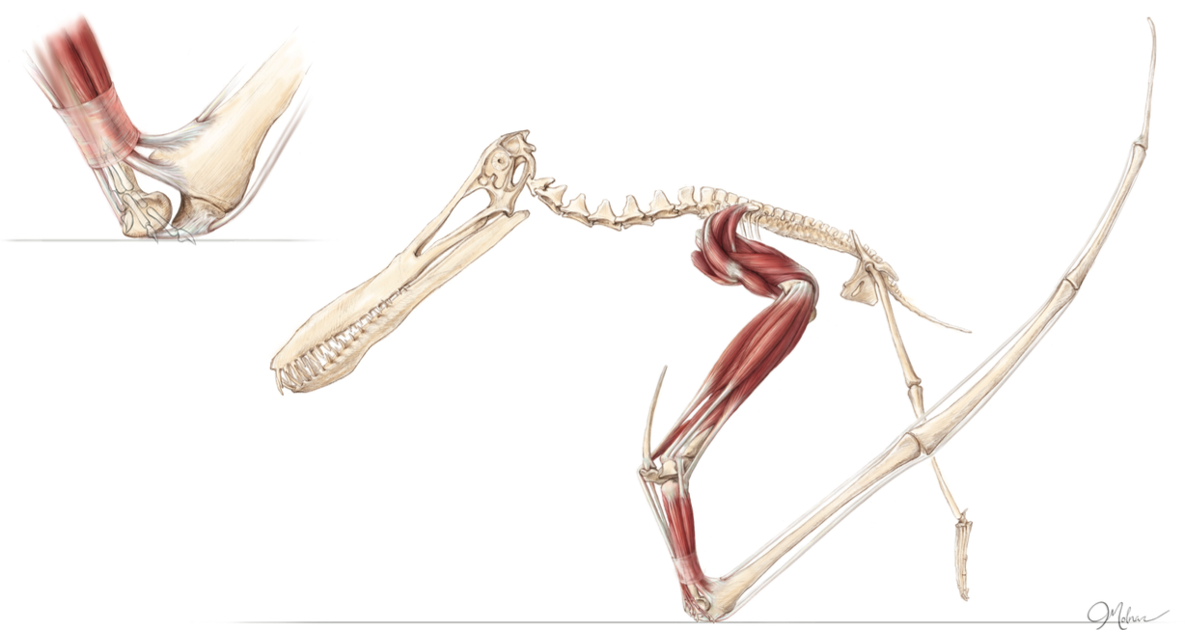
Quadrupedal launch
Julia Molnar

Slide 13
Conclusions
Flight power weak constraint
Landing and take-off more onerous
Pterosaur landing speed lower than birds
Launch stroke highly allometric
Quadrupedal launch advantage

Slide 14
The pterosaur advantage
Low flight speed capability
Forelimb muscle used for launch and flight
Long, powerful launch “stroke”

Slide 15
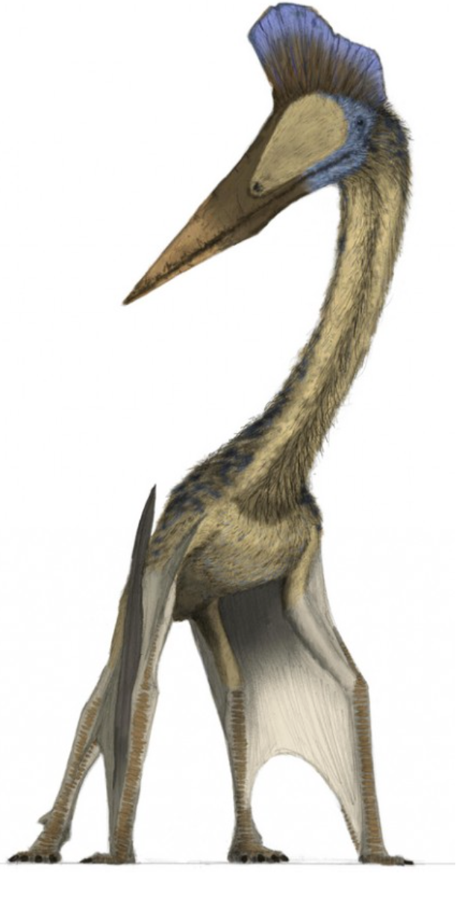
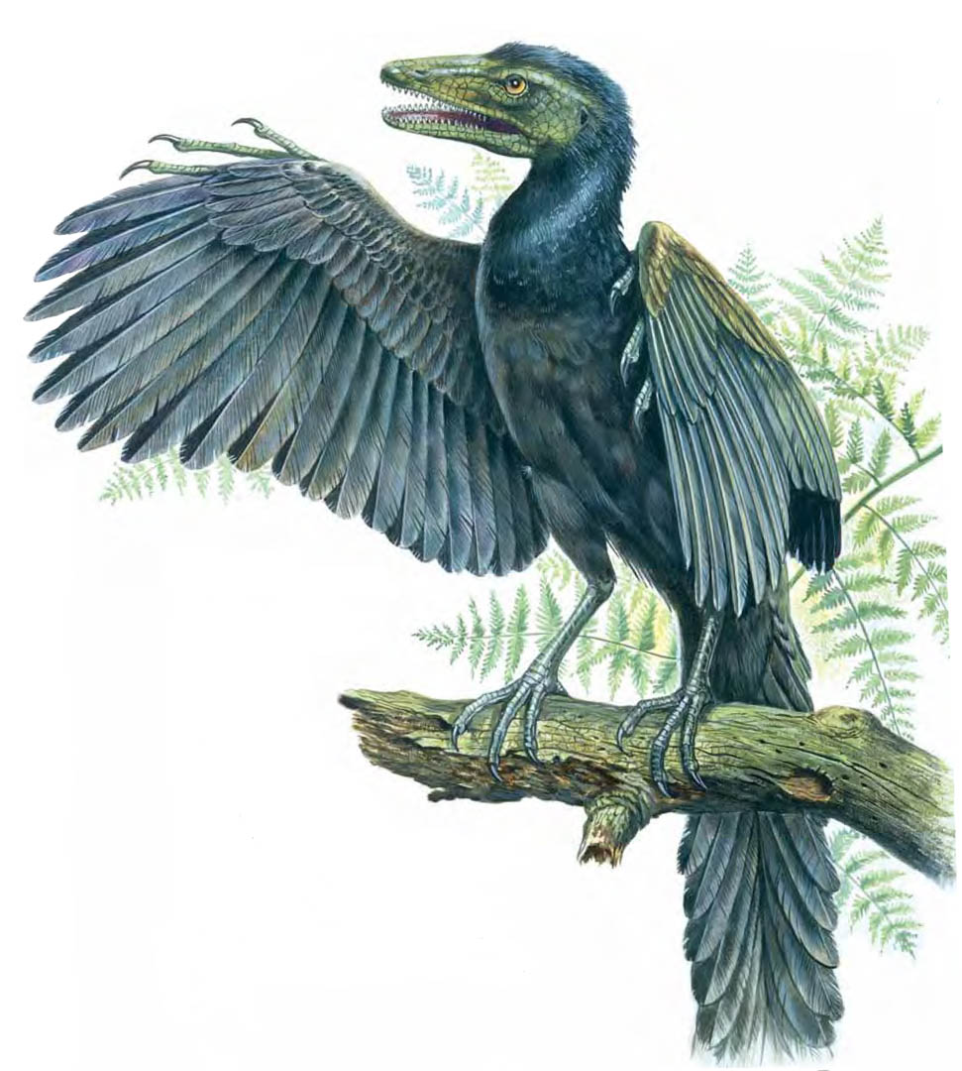
Hey, big fella!
NHM website
Mark Witton

Slide 16
Acknowledgements
Thanks to:
Mark Witton for his illustration
Jim Cunningham for sharing his ideas, insights and interest in flying giants
Emily Rayfield for her supervision of my PhD
Mike Benton for encouraging an engineer to venture into palaeontology

Slide 17
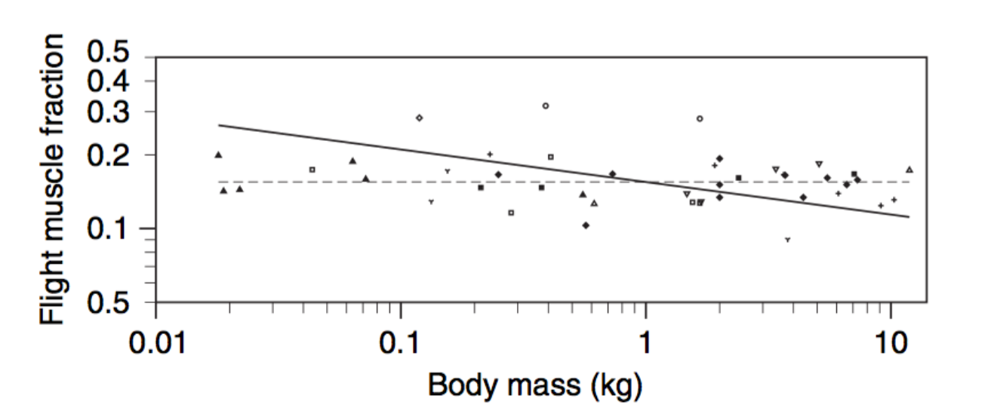
Flight muscle fraction
Pennycuick 2008

Slide 18
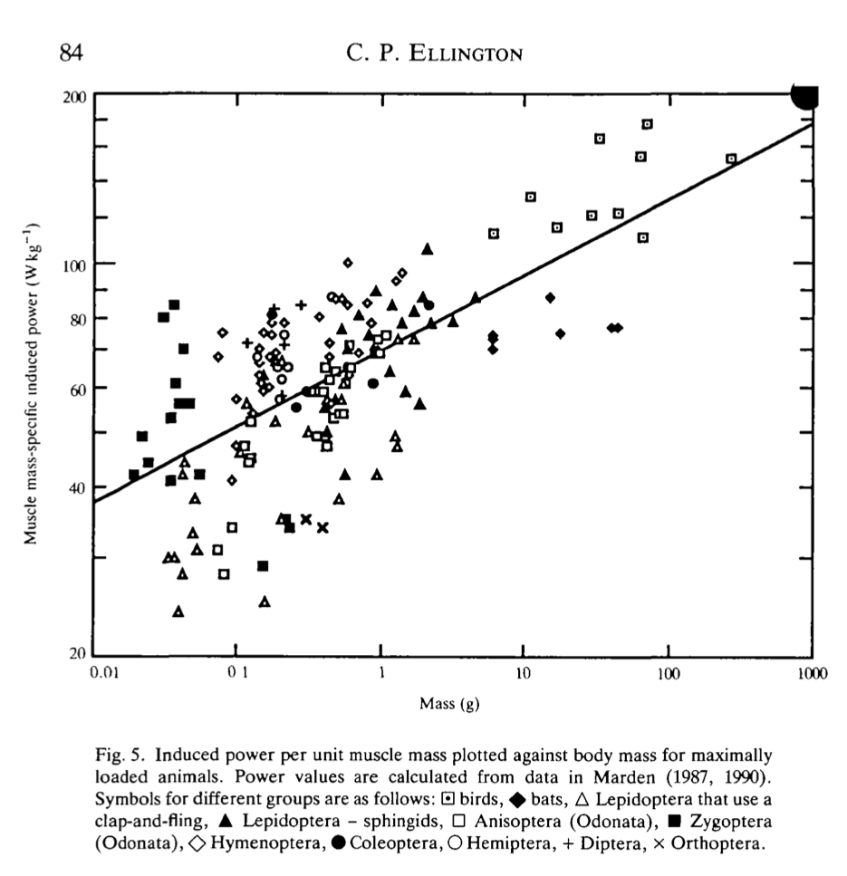
Muscle mass sp. power
100 W/kg
Power available W/kg
Body mass g
Ellington 1991

Slide 19
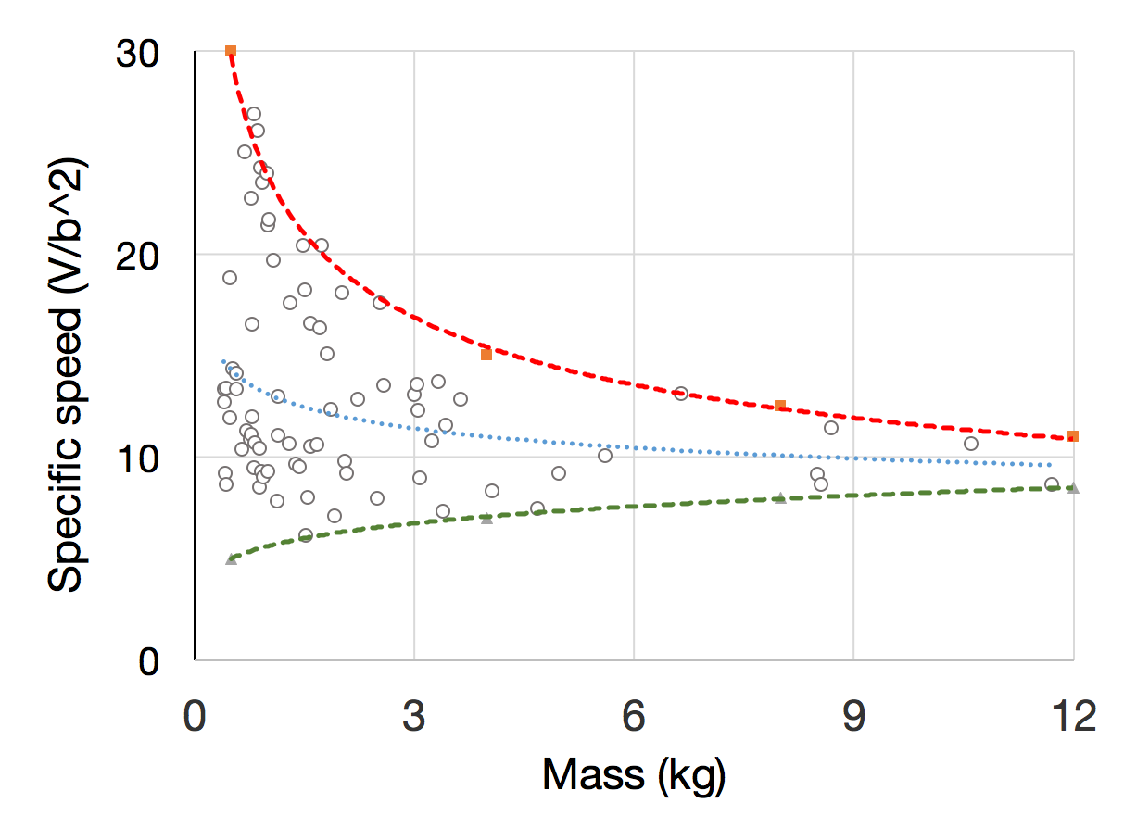
Flight speed

Slide 20
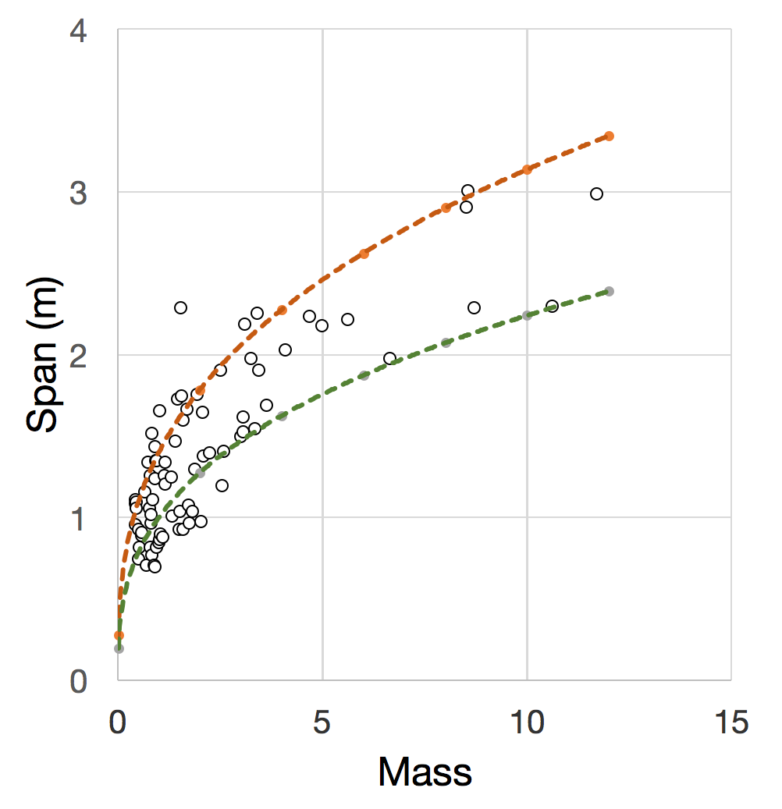
Wing span

Slide 21
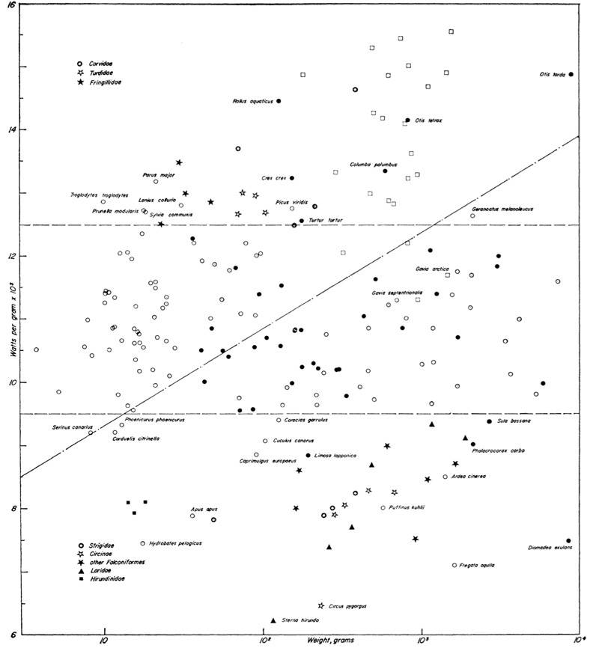
16
14
12
>2:1 range
Power required W/kg
10
8
6
0.01
0.1
1.0
10.0
Body mass kg
Greenewalt 1975

Slide 22
Staying up
Power required
  Lift:Drag ratio
  Flight speed
  Propulsive efficiency
Power available
  W/kg of muscle
  Frequency dependent?
  Muscle mass fraction
Pennycuick 1996,
Nudds et al 2004

Slide 23
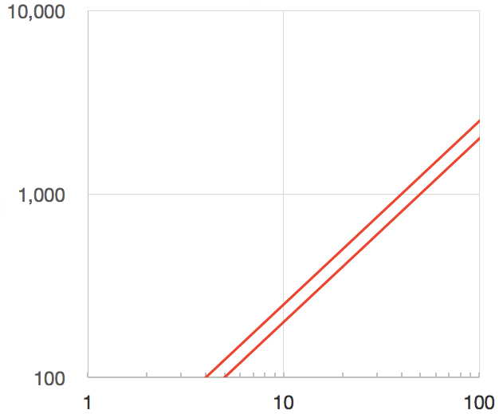
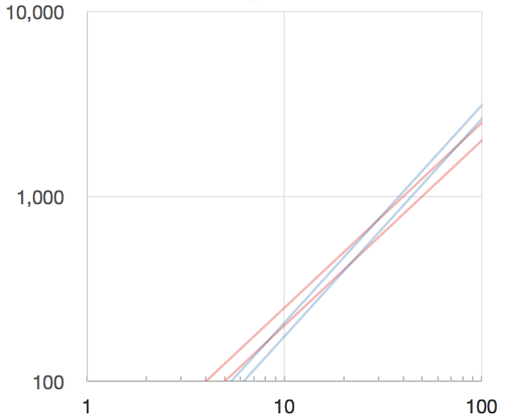
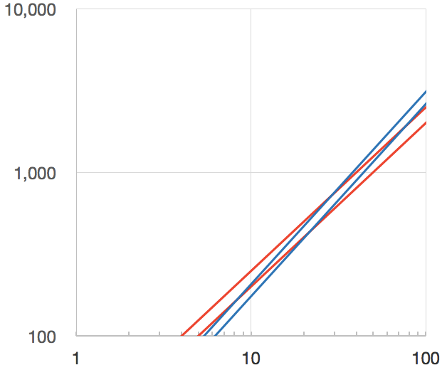
Power prediction
Power available
15-20% FMMF
Power required
Morphology variation
Power W
Variables
MMSP=100W/kg
L/D=12
Effic. =70%
Body mass kg

Slide 24
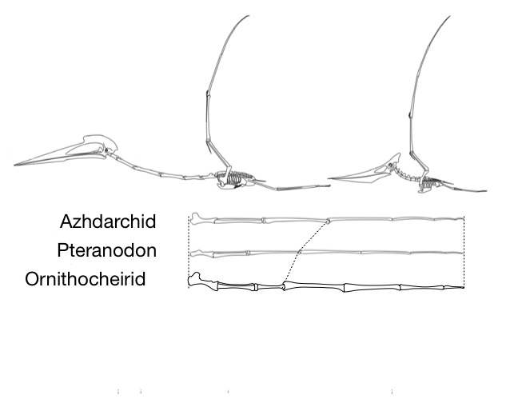
Wing bone allometry
Needs work

Slide 25
Staying in one piece
Wing spar bending
Bone sectional properties
Wing tip deflection
Stress distribution
Limited by tensile stress
Weak constraint on bone diameter

